Slide 1
Chapter 12
Session 1

Slide 2
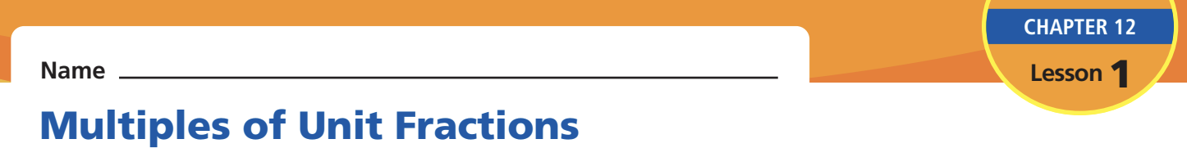
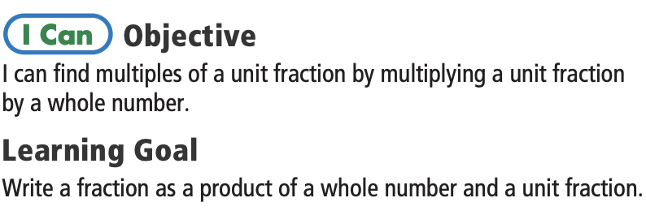

Book 2 : Page(469)
Time: 1 min
Fraction - a part of a whole
Session 1

Slide 3


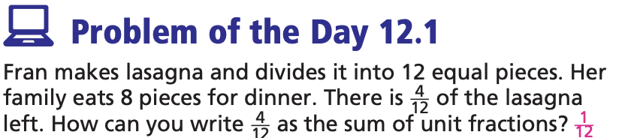
Session 1

Slide 4
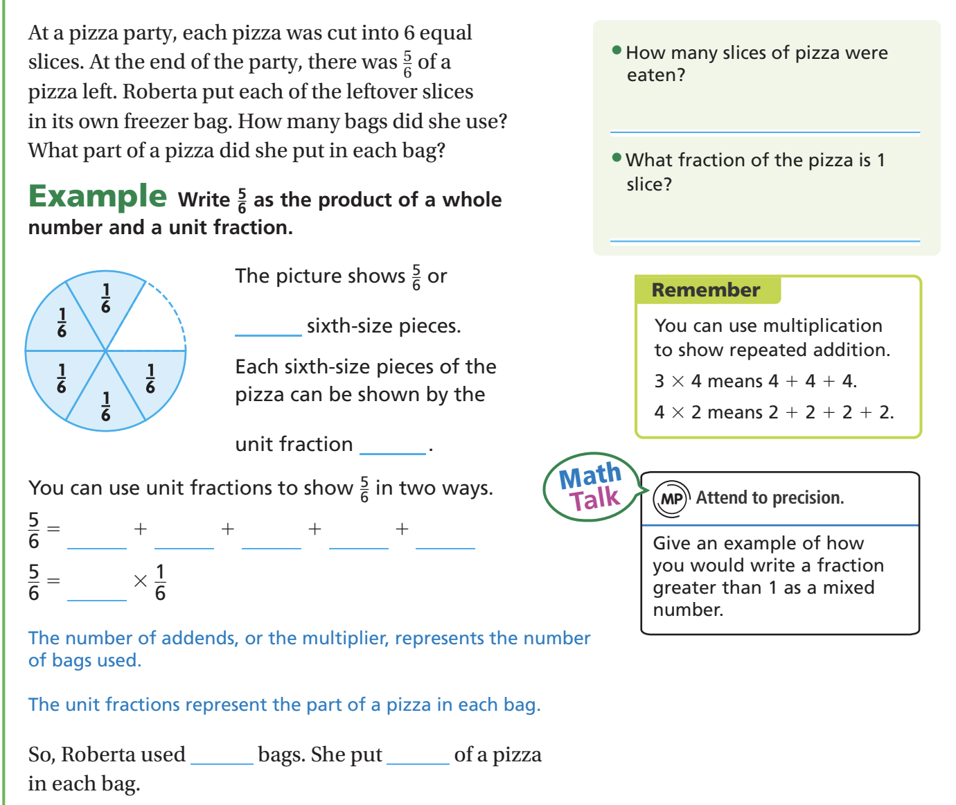
Book 2 : Page(469)
I DO
Session 1

Slide 5
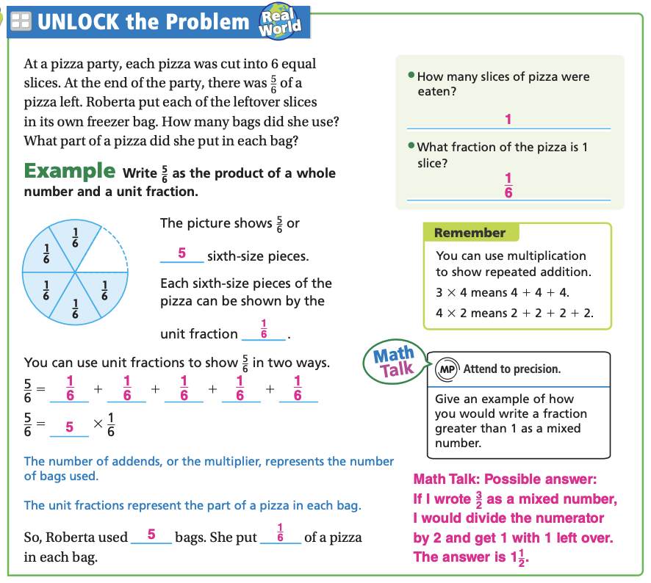
Book 2 : Page(469)
I DO
Session 1

Slide 6
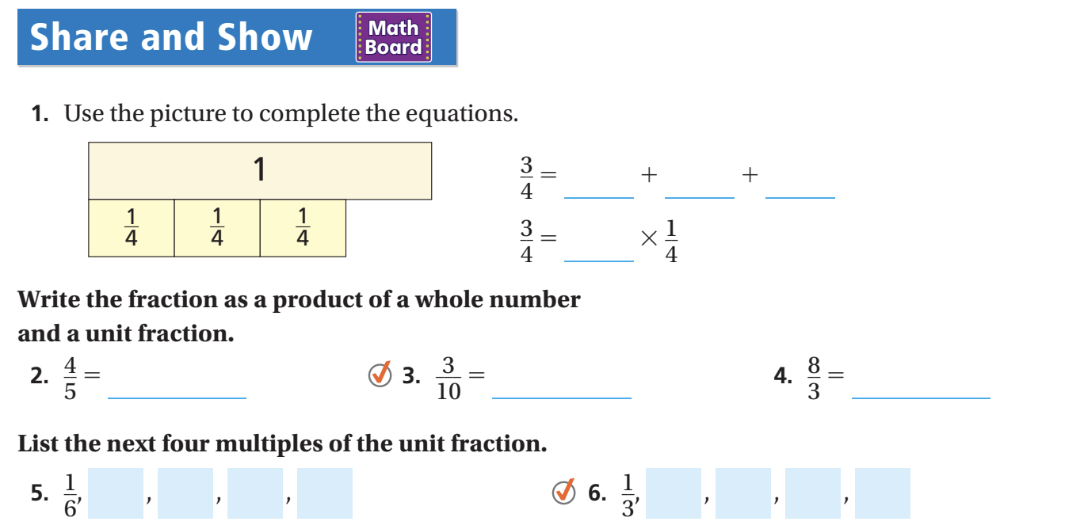
Book 2 : Page(469)
I DO
Session 1

Slide 7
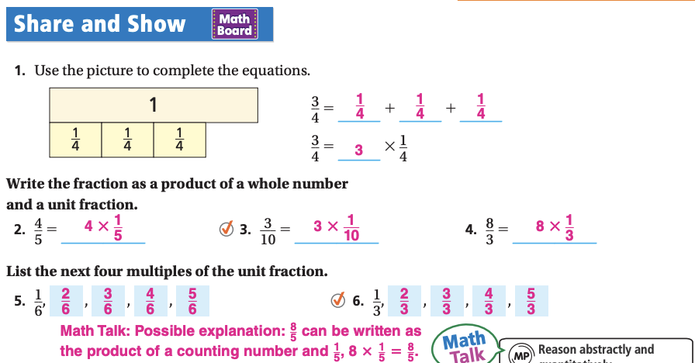
Book 2 : Page(469)
I DO
Session 1

Slide 8
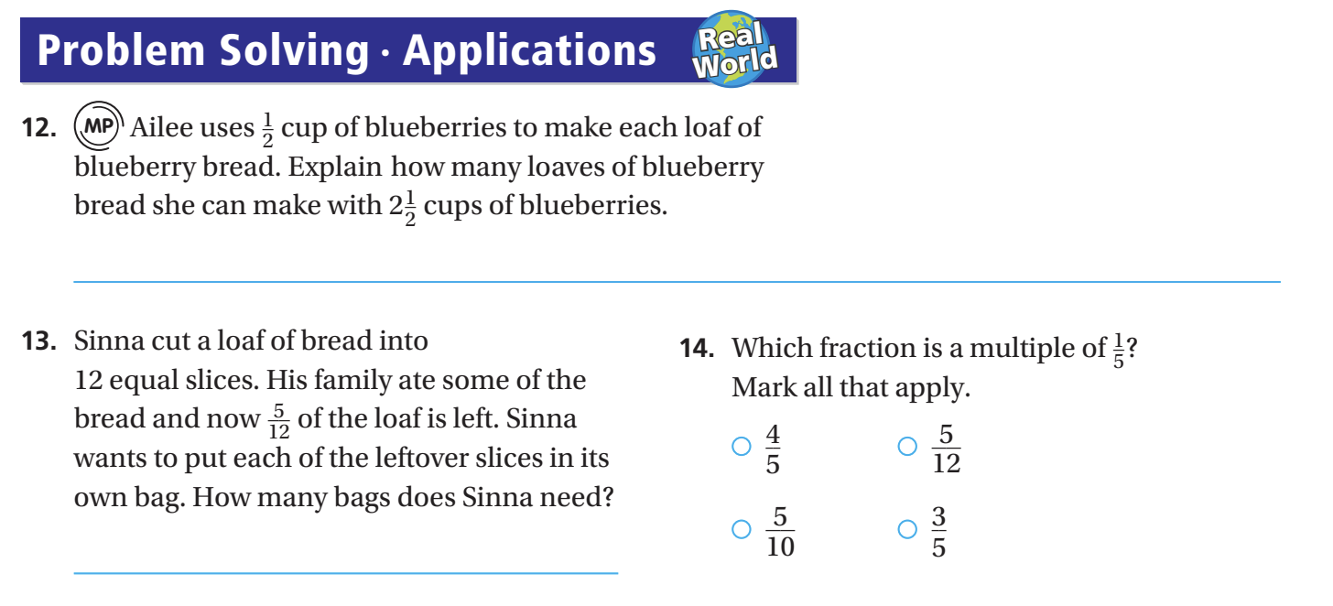
Book 2 : Page(469)
I DO
Session 1

Slide 9
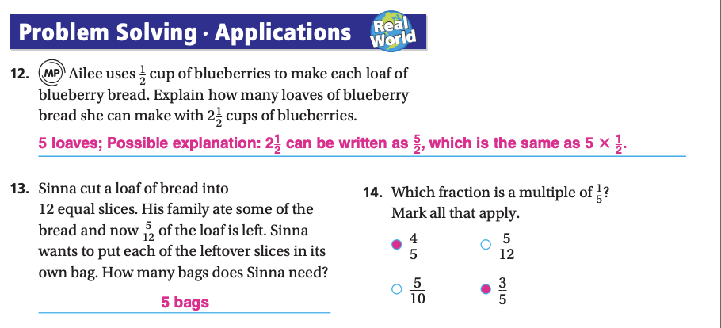
Book 2 : Page(469)
I DO
Session 1

Slide 10
Practice and Homework
Book 2 : Page(723)
Goal: Apply division to word problems + reasoning
Session 2

Slide 11
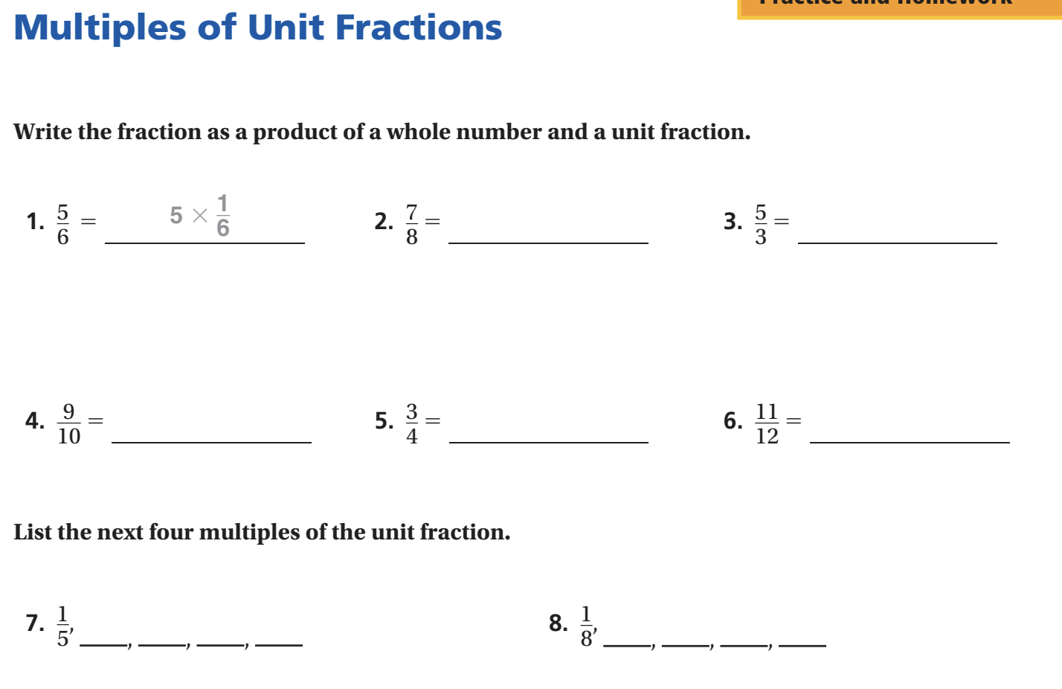
Book 2 : Page(473)
I DO
Session 1

Slide 12
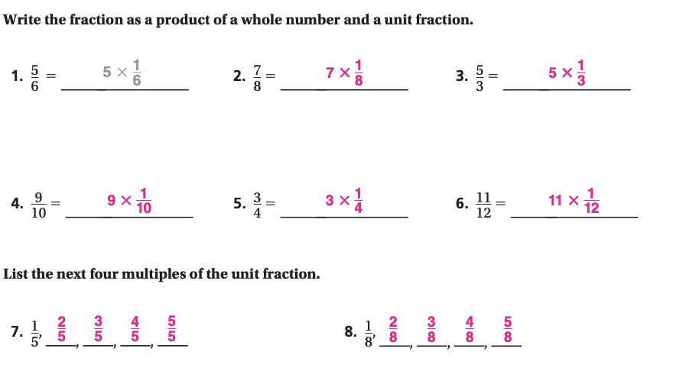
Book 2 : Page(473)
I DO
Session 1

Slide 13
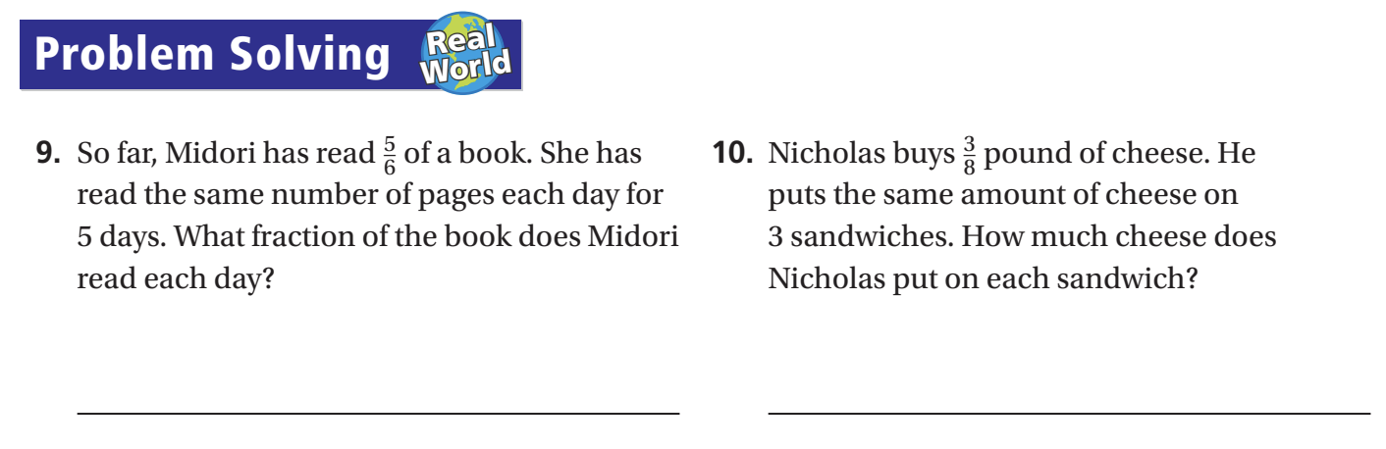
Book 2 : Page(473)
I DO
Session 1

Slide 14
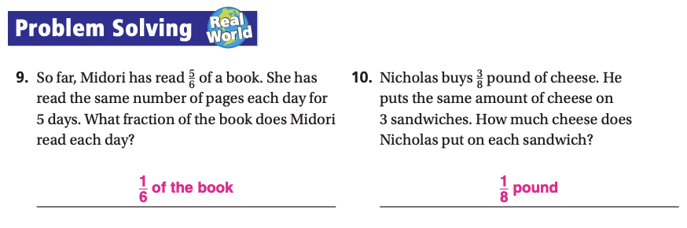
Book 2 : Page(473)
I DO
Session 1

Slide 15
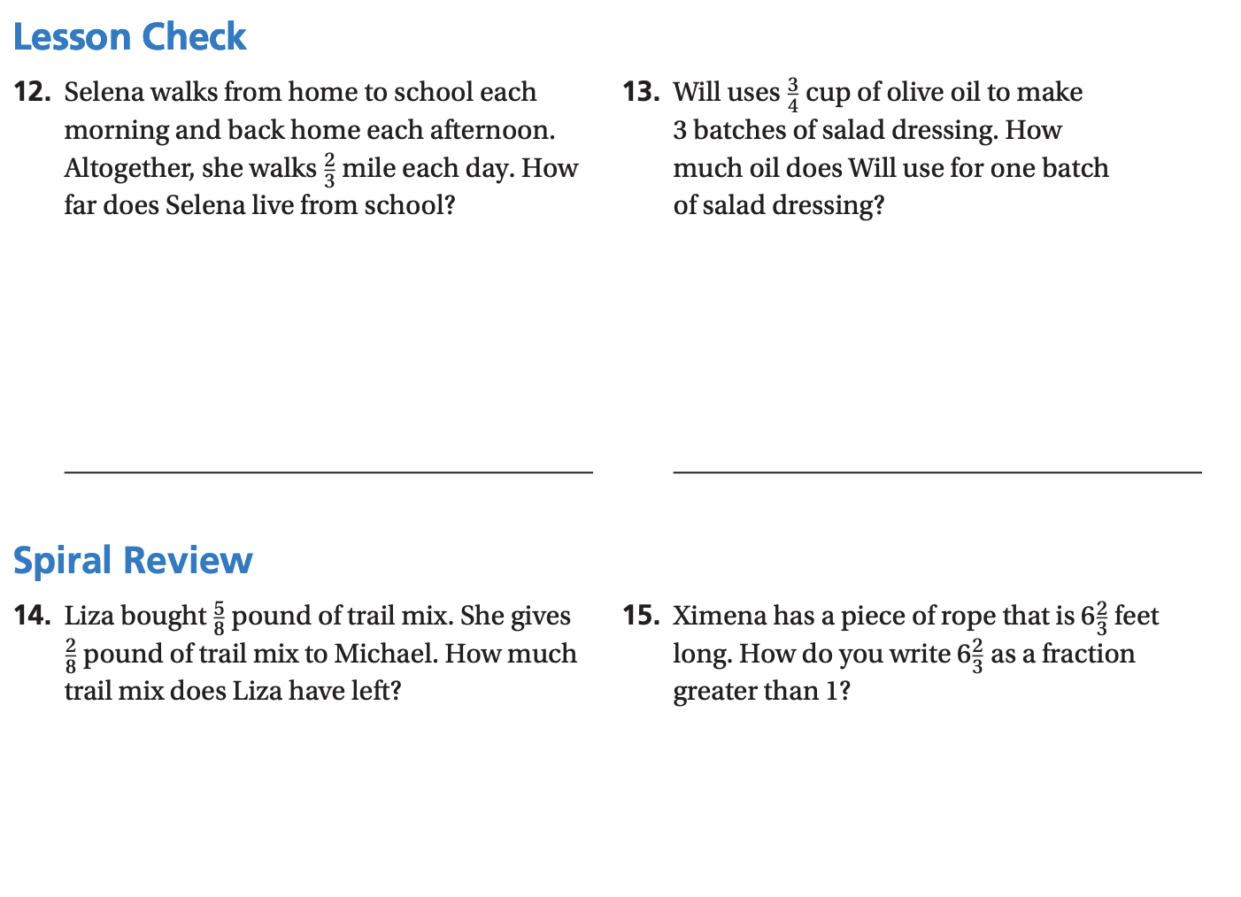
Book 2 : Page(474)
I DO
Session 1

Slide 16
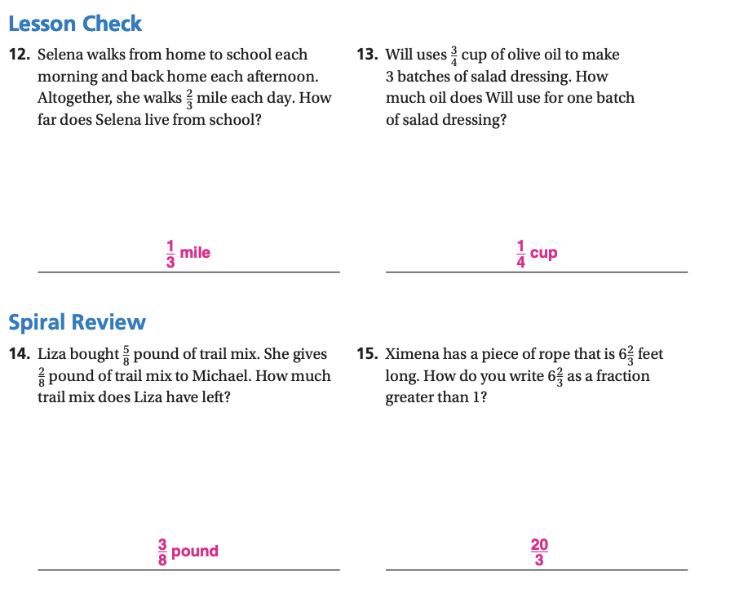
Book 2 : Page(474)
I DO
Session 1

Slide 17
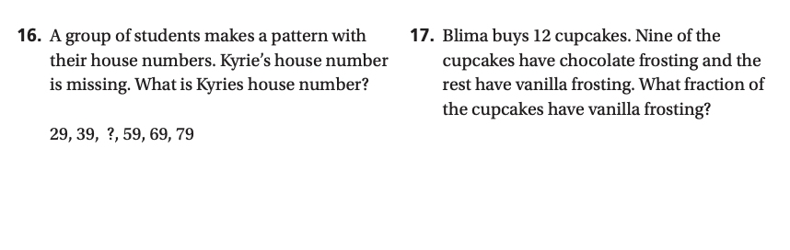
Book 2 : Page(474)
I DO
Session 1

Slide 18
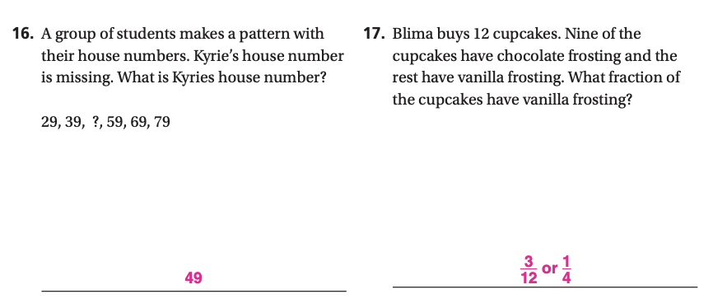
Book 2 : Page(474)
I DO
Session 1

